Slide 1
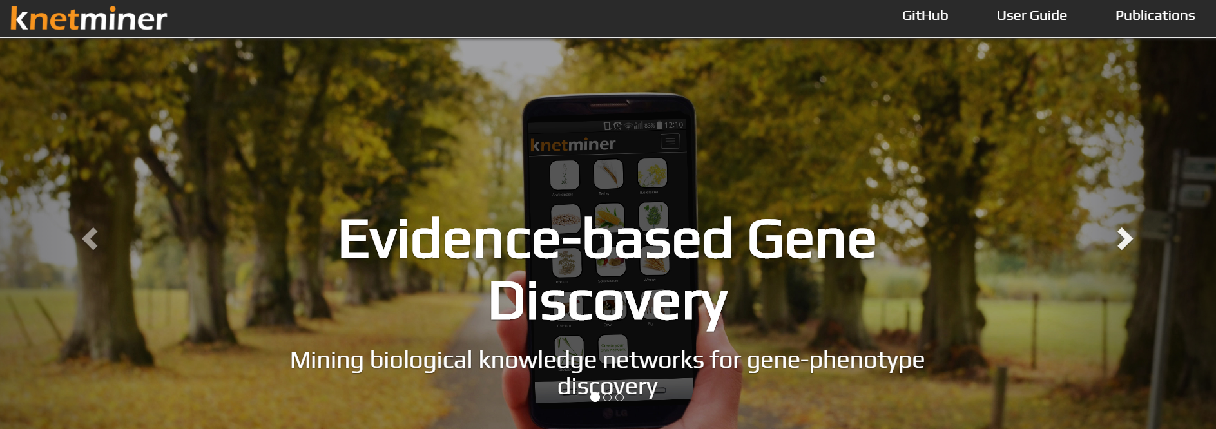


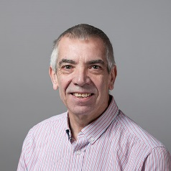
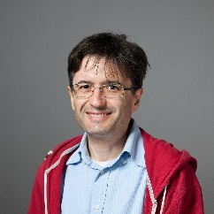

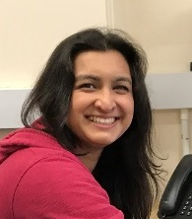
KnetMiner – Knowledge Network Miner
http://knetminer.rothamsted.ac.uk/
@KnetMiner
Notes:
KnetMiner, with a silent "K" and standing for Knowledge Network Miner, is a suite of open-source software tools for integrating and visualising large biological datasets. The software mines the myriad databases that describe an organism’s biology to present links between relevant pieces of information, such as genes, biological pathways, phenotypes and publications with the aim to provide leads for scientists who are investigating the molecular basis for a particular trait.

Slide 2
Roadmap to Crop Improvement
Allele Mining
Gene Mining
QTL/GWAS
Validation
Markers for breeding
Genome Assembly
Training

Slide 3
Learning objectives
To understand why data integration is needed
To learn which information types are useful for candidate gene prioritization
To understand the concept of knowledge networks/graphs
To learn about graph queries and gene ranking in KnetMiner
To use KnetMiner for the interpretation of RNA-seq, QTL, GWAS results

Slide 4
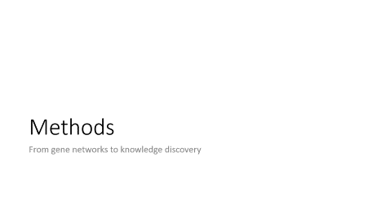

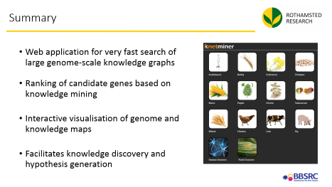
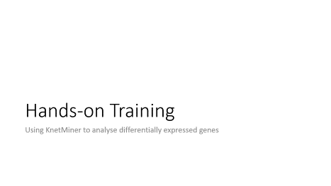
Overview

Slide 5
Introduction
Routes to candidate gene discovery

Slide 6
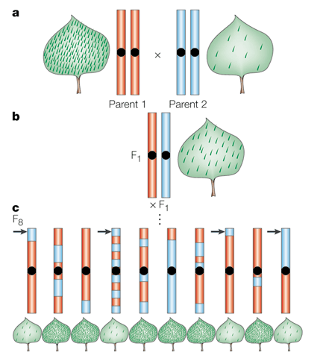
From QTL to gene(s)
QTL region can encompass 10s to 100s of genes.
How to prioritize genes?
Notes:
http://www.nature.com/nrg/journal/v2/n5/fig_tab/nrg0501_370a_F1.html
The basic strategy behind mapping quantitative trait loci (QTL) is illustrated here for a | the density of hairs (trichomes) that occur on a plant leaf. Inbred parents that differ in the density of trichomes are crossed to form an F₁ population with intermediate trichome density. b | An F₁ individual is selfed to form a population of F ₂ individuals. c | Each F₂ is selfed for six additional generations, ultimately forming several recombinant inbred lines (RILs). Each RIL is homozygous for a section of a parental chromosome. The RILs are scored for several genetic markers, as well as for the trichome density phenotype. In c, the arrow marks a section of chromosome that derives from the parent with low trichome density. The leaves of all individuals that have inherited that section of chromosome from the parent with low trichome density also have low trichome density, indicating that this chromosomal region probably contains a QTL for this trait.

Slide 7
Review the literature for 100 wheat genes…
Which resources/databases would you use?
How long would it take?
Cadmium accumulation QTL in wheat
Petal size QTL in Arabidopsis

Slide 8
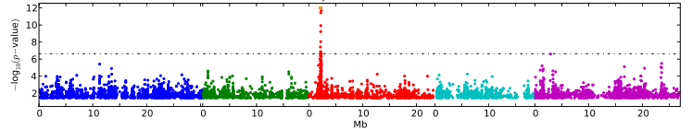
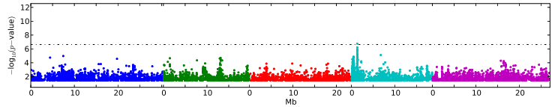
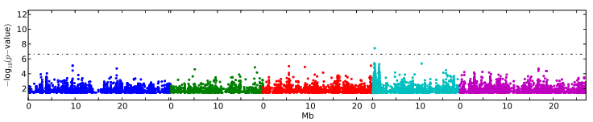
From GWAS to genes to molecular interactions
AvrRpm1
GWAS results can be complex to interpret
Peaks can be diffuse covering several hundred kb without a clear centre
Causal polymorphisms have not always strongest association
FLC gene expression (FLC)
Leaf Number (LN22)
Atwell et al., Nature 2010
Notes:
GWAS results can also be complex to interpret
LD in Arabidopsis decays within 10 kb on average
https://www.ncbi.nlm.nih.gov/pubmed/17676040

Slide 9
From GWAS peaks to genes to molecular interactions…
Which resources/databases would you use?
How long would it take?
Flowering time GWAS in Arabidopsis

Slide 10
Methods
From gene networks to knowledge discovery

Slide 11
Relevant biological information types
Gene-SNP-Trait
Gene-QTL-Trait
Protein-Protein Interaction
Gene-Function
Gene-Phenotype
Gene knock-out or overexpression
Co-occurrence in the literature
Gene-Publication
Protein-Pathway
Gene-Protein Regulation
Gene-Expression
Protein-Compound Interaction
Homology to other species
Data Integration can accelerate gene discovery and make it less subjective and more evidence-based.
Notes:
https://www.degruyter.com/view/j/jib.2017.14.issue-1/jib-2016-0002/jib-2016-0002.xml
http://www.sciencedirect.com/science/article/pii/S2212066116300308
TM provides access to brand-new information that is not yet available in structured databases
Modest post-TM-filtering is required to retain high-quality relations
TM for gene-phenotype adds 12k high-quality relations that were previously absent in the knowledge network

Slide 12
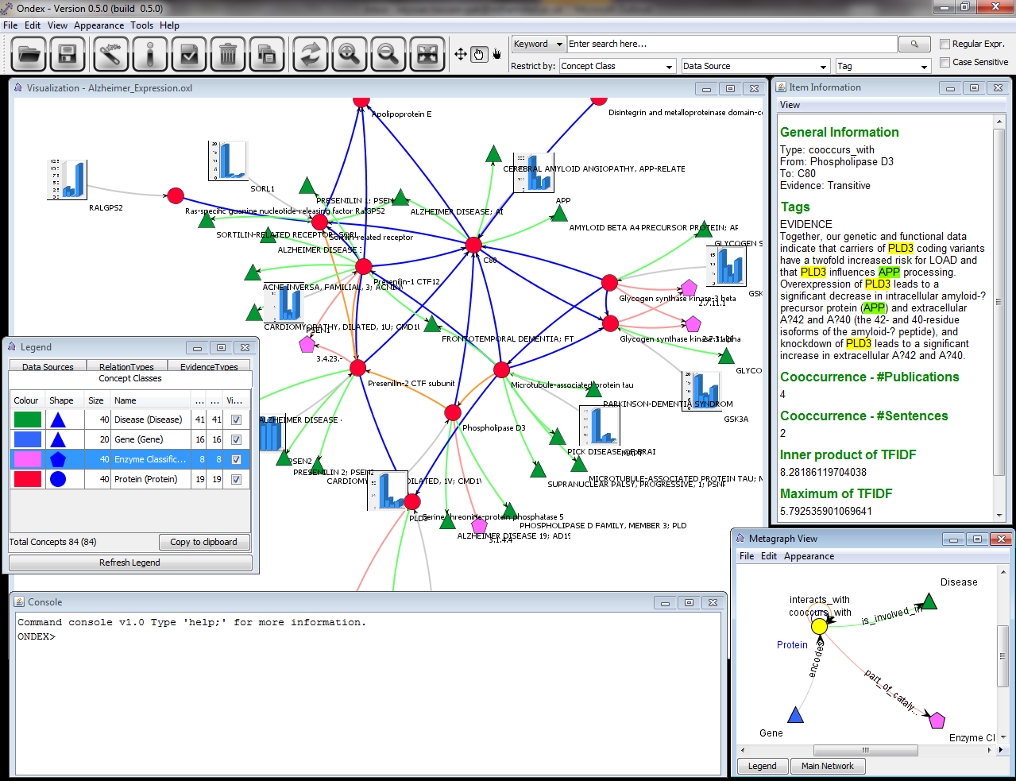
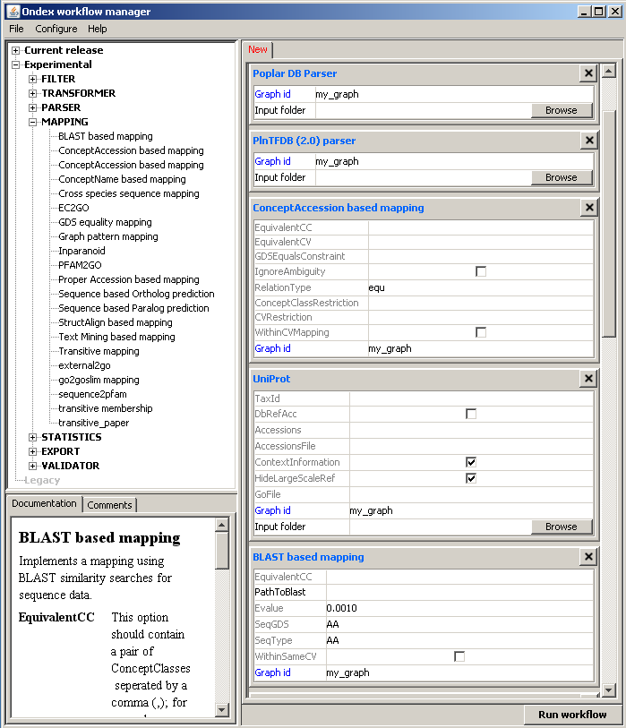
Ondex – Data Integration Platform
Free and open source
Data warehousing using a graph-database
Platform to integrate public and private datasets in various formats
Provides a GUI, CLI, APIs and workflows for reproducible data integration
In 2017, we slimmed down the Ondex code and moved it to Git.
https://github.com/Rothamsted/ondex-knet-builder

Slide 13
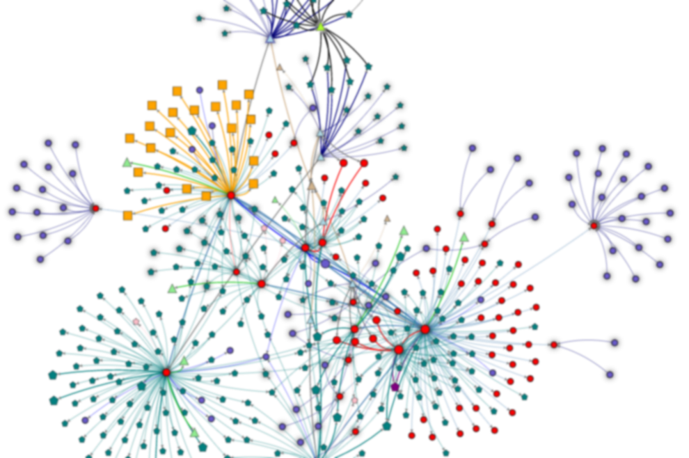
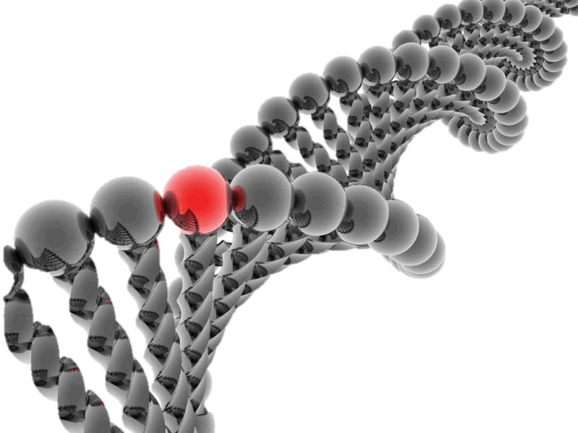
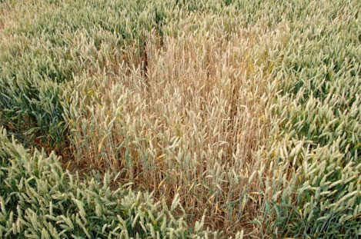
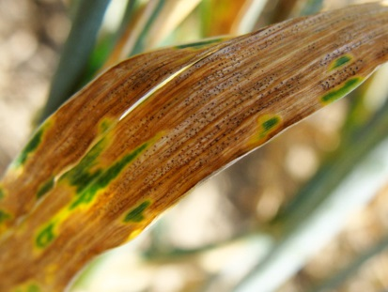
Building genome-scale knowledge networks
Genotype
QTL
GWAS
Integration
Integration
Omics
Transcriptomics
Proteomics
Metabolomics
Biological Knowledge Network
Prior knowledge
Structured, unstructured data
Cross-species data
Phenotype
Disease
Development
Stress tolerance
Hassani-Pak et al. 2016
Notes:
Many phenotypes are complex, polygenic and the result of complex interactions on cellular level
Linking genotype and phenotype is one of the greatest challenges in biology
Update to new IWGSC RefSeq in liaison with Ensembl Plants (Feb 2018)

Slide 14
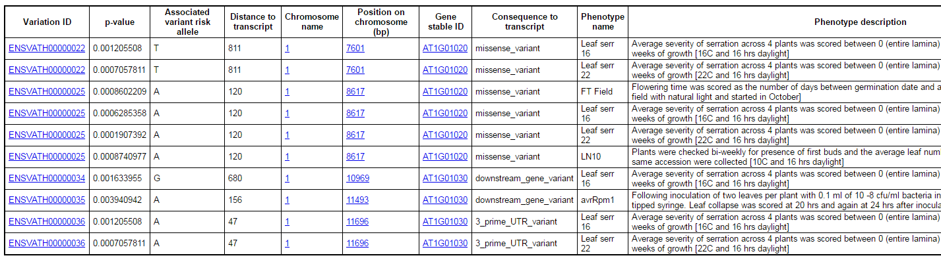
Let’s start with some GWAS data…
Example Arabidopsis
#SNP=66,816 | #Gene=27,502 | #Phenotype=107
http://plants.ensembl.org/biomart
Notes:
SNP-Phenotype relations (122,919 relations) of significant SNPs (as defined by Ensembl, p-value<0.05?) linked to 107 phenotypes; on average 1,150 SNPs per phenotype.
SNP-Gene relations are based on genes in close proximity to SNPs <1000bp (96,047 relations)
How to integrate GWAS and biological interaction data

Slide 15
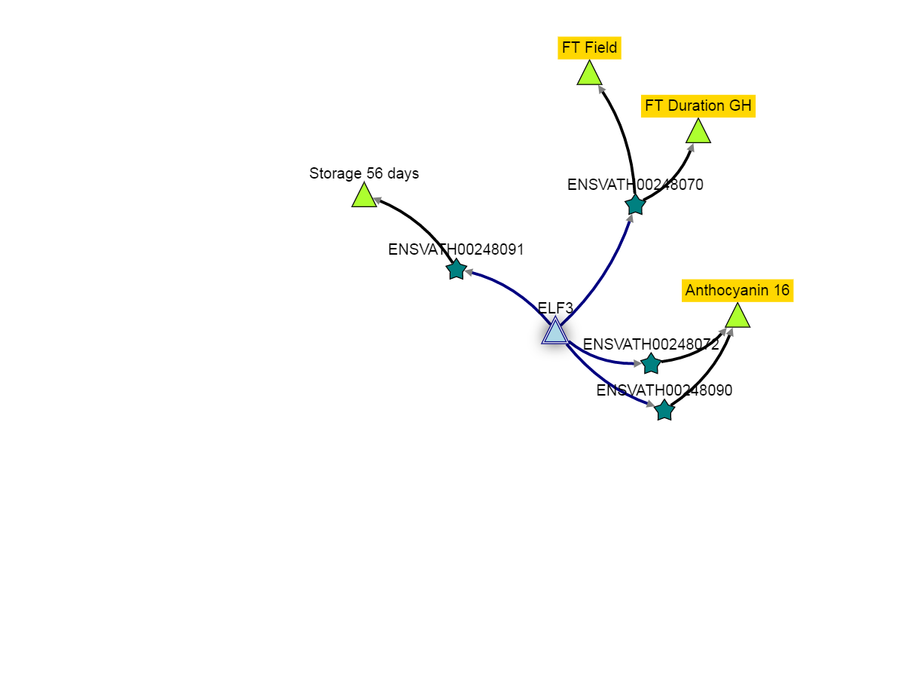
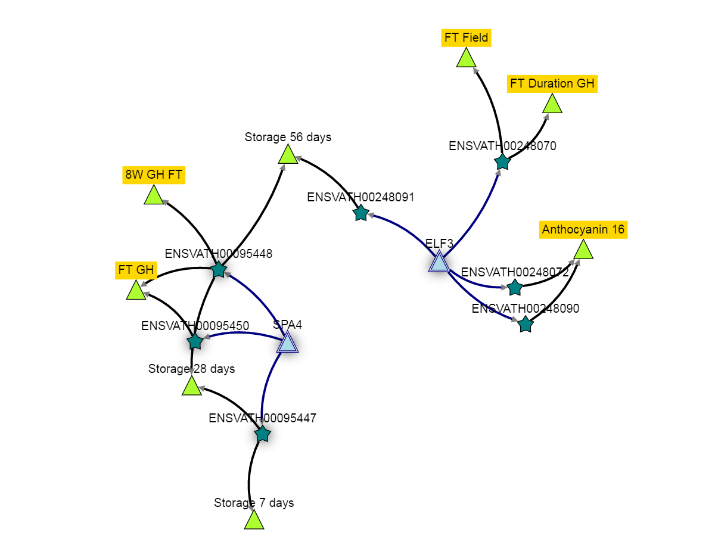
… transform into a network
(Phenotype)
associated
(SNP)
close to
Notes:
Using Ondex

Slide 16
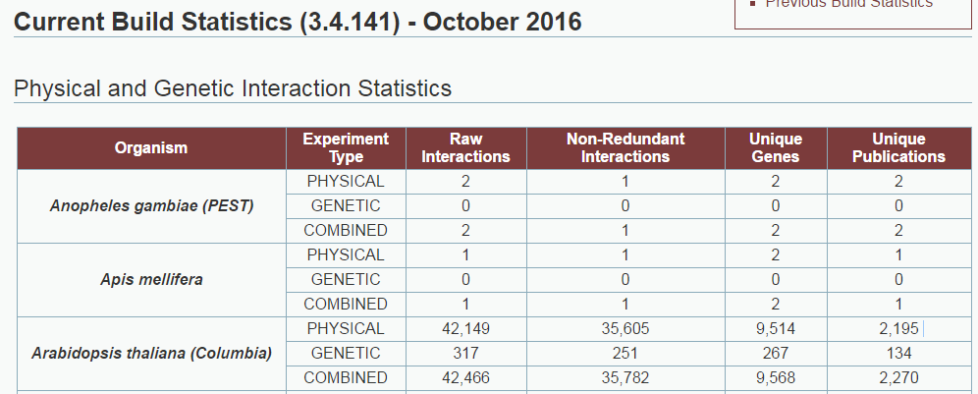
Biological interaction datasets
http://thebiogrid.org

Slide 17
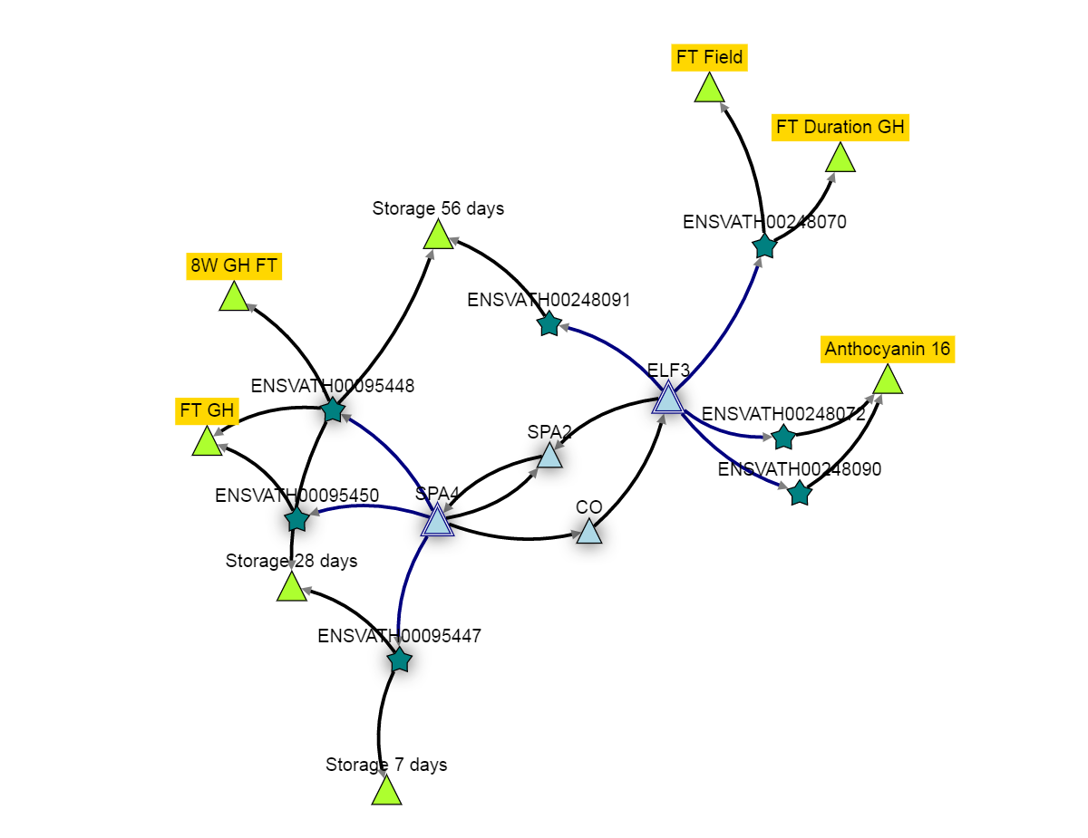
… add biological interactions
(Phenotype)
associated
(SNP)
close to
interacts
interacts

Slide 18

How to search and interpret so much information?
Methods needed to evaluate millions of relationships in knowledge network, prioritize genes and extract relevant subnetworks
Interactive and exploratory tools needed to enable knowledge discovery and decision making
Interpretation should be the task of domain experts i.e. biologists!
Notes:
Scale: As these networks combine a wide variety of entities which are derived by parsing large volumes of data, they are quite large. A typical plant knowledge network created using Ondex has around 100,000 genes linked amongst 500,000 concepts (can be genes, proteins, SNP’s, publications) in approx. 1-1.5 million interactions/ relations.
KnetMiner was developed to enable users to interactively explore such large, genome-scale knowledge networks and extract relevant plausible pathways linking candidate genes to agronomic traits.
KnetMiner works by querying a species-encompassing knowledge network to mine its data and retrieve “relations” (i.e., links/ connections) between the various entities (called “concepts”) within the network, such as genes, proteins, phenotypes, SNP’s and publications.
This helps create a pathway that can be visually traversed to understand how various biological entities are inter-linked and how a gene might influence a specific phenotype/ trait.

Slide 19
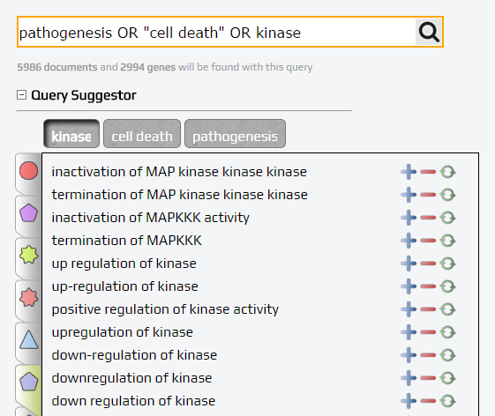
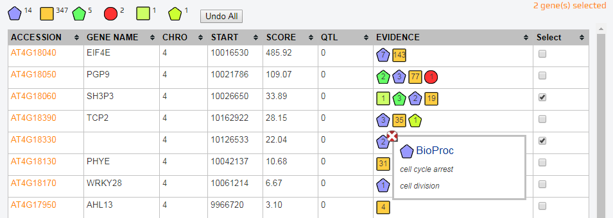
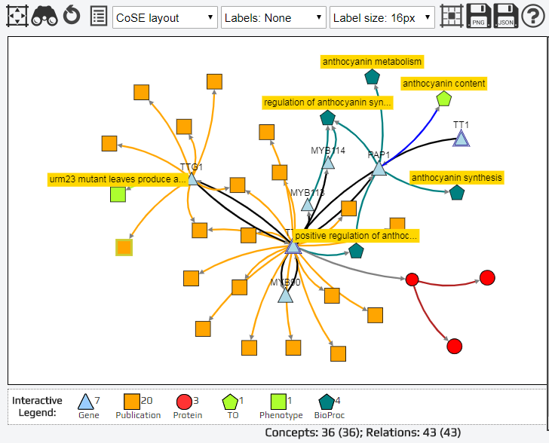
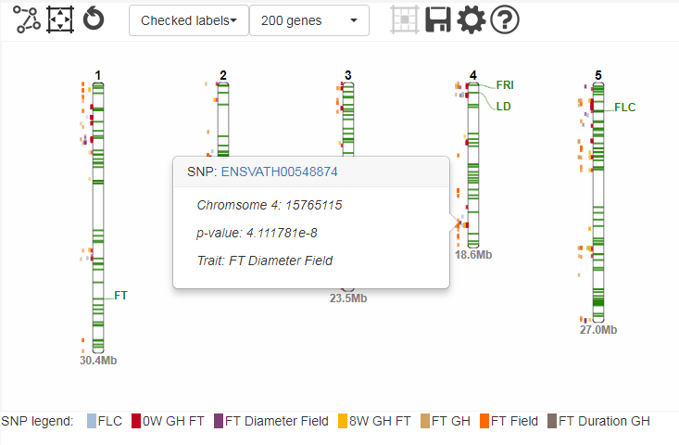
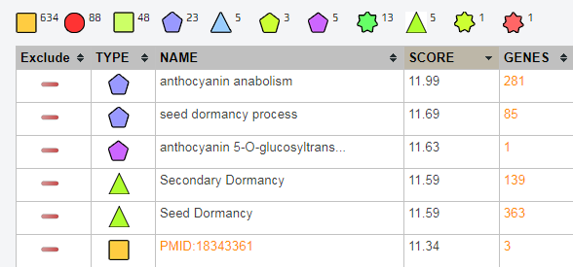

KnetMiner – Gene Discovery Platform
Search
Select
Explore
http://knetminer.rothamsted.ac.uk/
Notes:
KnetMiner is web-based app to search, select and explore a vast amount of information. We try to make the software intuitive and fun to use and embed the user into the discovery process
Achim: “KnetMiner is a great example for how an easy-to-use software app should look like. Even I can figure it out without being a techie or having to read a thick manual. “

Slide 20
Hands-on Training
Using KnetMiner to analyse differentially expressed genes

Slide 21
New Release of Wheat KnetMiner
RefSeq v1.0 high confidence genes (IWGSC)
Co-expression data (JIC)
Gene Regulation data (JIC)
TILLING data (Rothamsted)
Homology information (Ensembl Plants)
GWAS data (Cornell T3)
Wheat publications (PubMed)
Gene-Phenotype from literature (Rothamsted)
Arabidopsis knowledge (many sources)
http://knetminer.rothamsted.ac.uk/Triticum_aestivum/

Slide 22
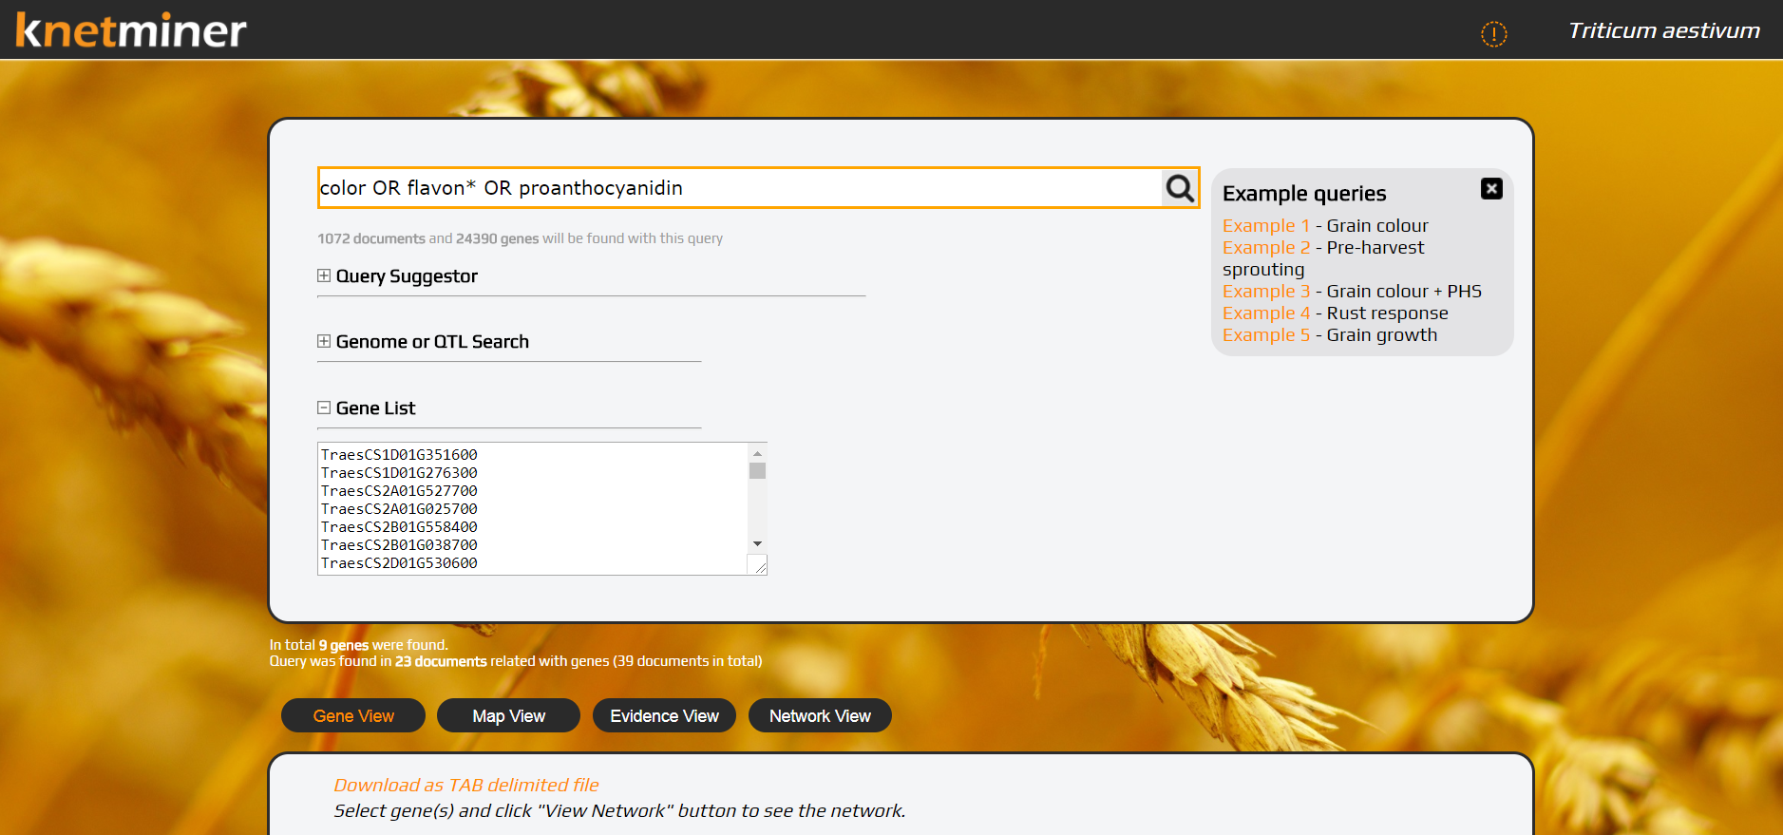
Connecting the dots in wheat data

Slide 23
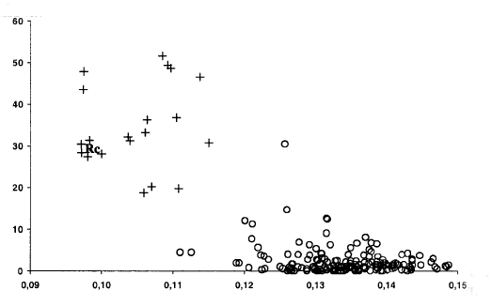
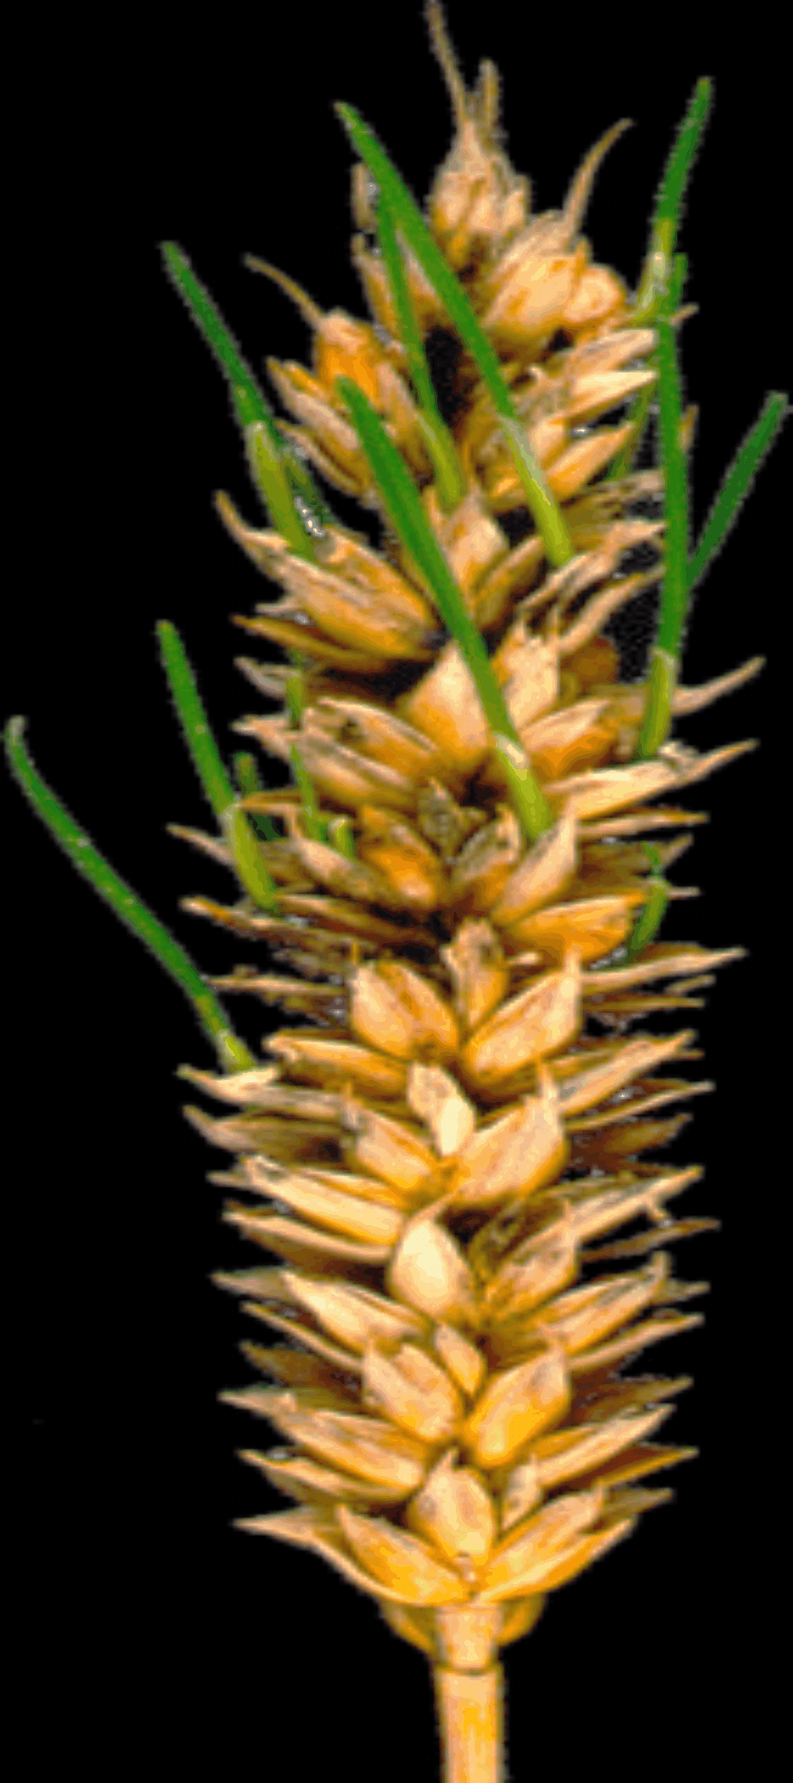
White grained wheat is more prone to pre-harvest sprouting (PHS)
+ = white
Sprouting
o = red
Grain colour
Groos et al. (2002)TAG 104, 39-47
PHS is the result of premature germination of grain in the ear and results in loss of bread-making quality
Red grain colour is associated with increased dormancy and resistance to PHS
Grain colour is due to proanthocyanidins (condensed tannins) in the testa
Red grain 20dpa
Andy Phillips

Slide 24
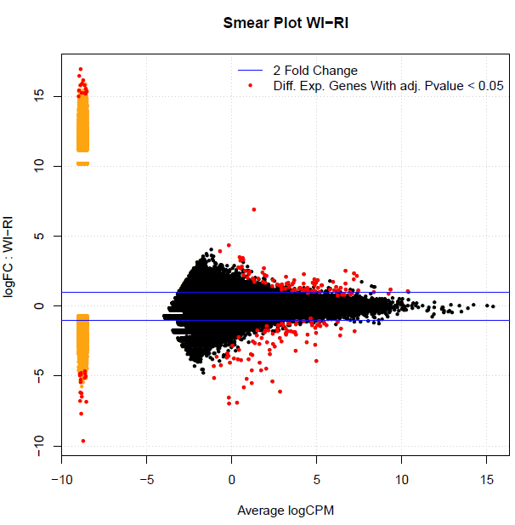
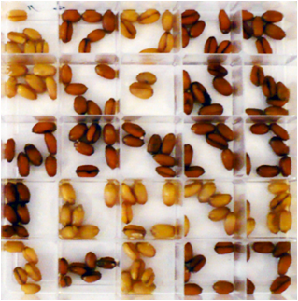
Differential Gene Expression Analysis
Mutation in R Myb (TT2) gene leads to change of grain colour from red to white.
Over hundred statistically significant genes in white vs. red grain RNA-seq.

Slide 25
Use cases for integrative data analysis
Link between grain colour (R gene) and PHS
Analysing GWAS peaks for rust response
Analysing QTL for grain fill duration
Use KnetMiner helps to answer questions such as:
Which genes contribute to the expression of trait A (e.g. grain colour)?
Which genes contribute to the expression of trait B (e.g. PHS trait)?
Which biological processes and pathways are underlying these traits?
Which other processes and traits will be affected by loss-of-function mutants?

Slide 26
Tutorial
Google for: KnetMiner (http://knetminer.rothamsted.ac.uk/)
Open the User Guide (http://knetminer.rothamsted.ac.uk/KnetMiner_Tutorial.pdf)
Follow the exercises
Try out the latest KnetMiner beta-version
http://arabidopsis.eu-west-2.elasticbeanstalk.com/client/

Slide 27
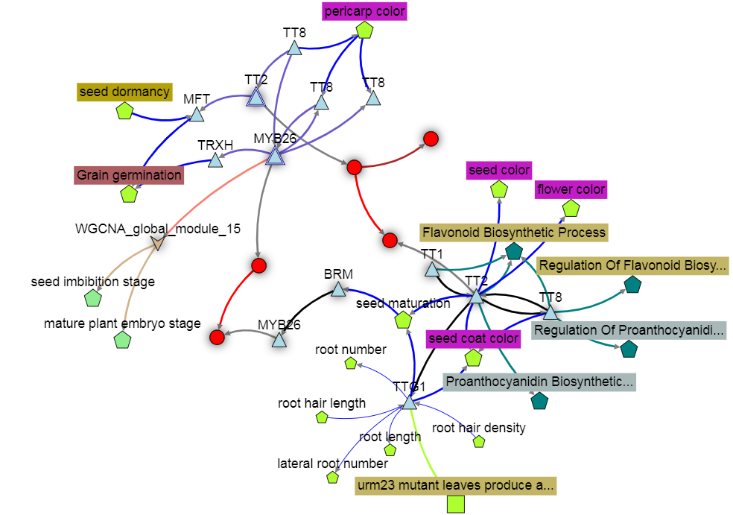
Integrative data analysis can generate new hypotheses, for example:
Grain colour and PHS are linked because the grain colour gene R Myb regulates the expression of the grain germination gene MFT.
White grain varieties (R Myb mutants) have increased root hair density.
Increased root hair density is the cause for PHS.

Slide 28
Future vision – Automatic summarization of networks
TT2 (R Myb) on chromosome 3D in wheat is predicted (p-value=0.01) to regulate the transcriptional activation of MFT according to data from the analysis of 850 RNA-seq samples in wheat (Ramírez-González et al. 2018) using GENIE3 (Huynh-Thu et al. 2010). The TT2 3B homeologue is not predicted to regulate MFT, and the TT2 3A homeologue is not annotated in the latest version of the wheat genome (The International Wheat Genome Sequen...). MFT has been recently linked to grain germination [(Zong Y ; Li Q ): “Recent studies in both Arabidopsis and wheat have uncovered a new role of MOTHER OF FT AND TFL1 (MFT) in seed germination”] and seed dormancy [ (Nakamura S ): “Mapping analysis showed that MFT on chromosome 3A (MFT-3A) colocalized with the seed dormancy quantitative trait locus (QTL) QPhs.ocs-3A.”]. The MFT ortholog in Arabidopsis has a 3’ UTR variant that has been associated with (p-value = 5.5x10-5) increased germination rate after 56 days of dry storage (Atwell et al. 2010).

Slide 29
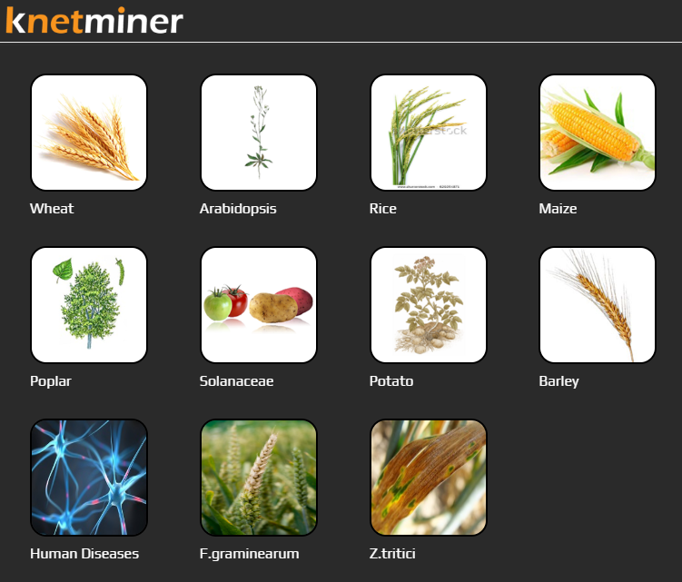
Summary
KnetMiner shows the power of integrating Linked Open Data
Provides very fast search of large genome-scale knowledge graphs
Combines graph analytics with interactive data visualisation
Interested to have KnetMiner for your species? Contact us.

Slide 30



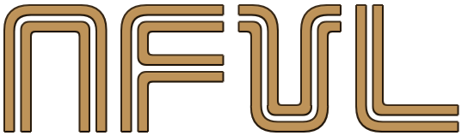






Acknowledgements
Bioinformatics Lab
Ajit Singh
Marco Brandizi
Emma Bailey
Alisha Ahamed
David Hughes
Rob King
Dan Smith
Head of Group
Keywan Hassani-Pak
Head of Department
Chris Rawlings
Sergio Feingold
Martin Castellote
Misha Kapushesky
Kevin Dialdestoro
Richard Holland
Cristobal Uauy
Philippa Borrill
Ramil Mauleon
Kenneth McNally
Nickolai Alexandrov
Dave Edwards
Philipp Bayer
John Doonan
@KeywanHP
Uwe Scholz
Matthias Lange

